Slide 1
Version Control Systems and working with console

Slide 2
Agenda
Recap
What is computer console?
Useful console commands
What is VCS?
Why we need VCS?
Branching
Merging

Slide 3
Agenda
VCS types
Popular VCS
GIT
GIT installation
Work with GitHub
Git commands
Exercises

Slide 4
Recap
What is Quality?
Difference between QA and QC
Principles of testing
Expected result sources
What is a bug? When we have a bug?

Slide 5
What is computer console?
Computer console is a way to execute actions without using GUI of your OS
Using the console you can do anything with your OS – create, rename, delete, move, copy etc. files and directories, user administration, installations, scheduling, restart, shutdown etc.
Very powerful tool

Slide 6
Useful console commands
Windows
List of commands
Unix
List of commands
Online Unix terminal
Mac
List of commands

Slide 7
What is VCS?
It is a software tool
Version control (aka Revision control aka Source control)
Keep track of code/documentation/test changes
Allows “versioning” in easier and reliable way
Make the team work in IT possible and effective

Slide 8
Why we need VCS?
Keeps history of every change
Working on a big projects is impossible without VCS
“Play” with file changes and undo
Play in a sandbox
Traceability
Ownership
Branching and merging

Slide 9
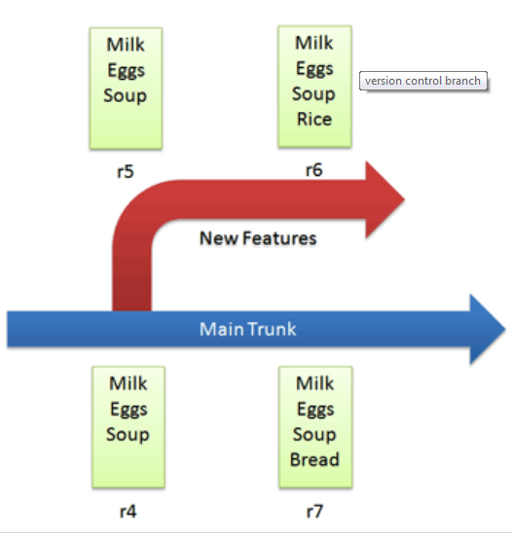
Branching
Source: https://betterexplained.com/articles/a-visual-guide-to-version-control/

Slide 10
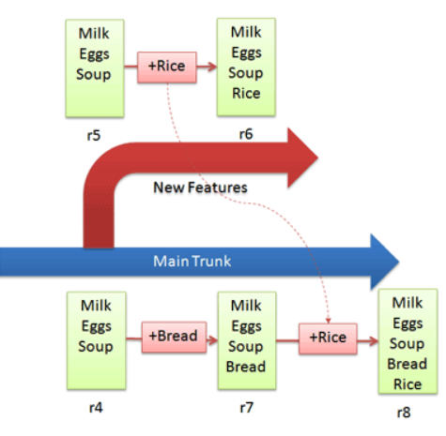
Merging
Source: https://betterexplained.com/articles/a-visual-guide-to-version-control/

Slide 11
VCS types
Centralized VCS (CVCS)
Distributed VCS (DVCS)

Slide 12



Popular VCS
CVS

Slide 13
GIT
First developed by Linus Torvalds
Free open source DVCS

Slide 14
GIT installation
Windows
Win installer
Unix/Linux
Linux instructions
Mac
Mac instructions

Slide 15

Work with GitHub
How it works?
Create an account in GitHub
Create your first repository
Clone your repository on local machine
Start adding changes

Slide 16
Git commands
git init - This creates a new subdirectory named .git that contains all of your necessary repository files — a Git repository skeleton. At this point, nothing in your project is tracked yet.

Slide 17
Git commands
git clone URLtoRepository - If you want to get a copy of an existing Git repository — for example, a project you’d like to contribute to
Example: If you have opened a console and navigated to C:\Users\Username\Desktop\GitProjects and execute
git clone https://github.com/htjurkmen/softwaretesting1109.git
Git will clone the project under softwaretesting1109 folder.

Slide 18
Git commands
git clone URLtoRepository localFolder - If you want to clone the repository into a directory named something different than default
Example: If you have opened a console and navigated to C:\Users\Username\Desktop\GitProjects and execute
git clone https://github.com/htjurkmen/softwaretesting1109.git test
Git will clone the project under test folder.

Slide 19
Git commands
git add filename - In order to begin tracking a file, you use this command
Example: If you have opened a console and navigated to C:\Users\Username\Desktop\GitProjects\YourProject and execute
git add someexistingfile.extension
Git will start tracking this file for you

Slide 20
Git commands
git add . - In order to begin tracking all untracked files, you use this command
Example: If you have opened a console and navigated to C:\Users\Username\Desktop\GitProjects\YourProject and execute
git add .
If you have more than one untracked file for ex. File1.txt and File2.js Git will start tracking all files for you

Slide 21
Git commands
git status - to determine which files are in which state and the current status of your actions
Example: If you have opened a console and navigated to C:\Users\Username\Desktop\GitProjects\YourProject and execute
git status
Git will show you tracked/untracked files, committed files, the branch you use now, if you have something to add/commit, if you are in merging state, if you have conflicts etc.
Run this command often to see what is your current state. Very useful.

Slide 22
Git commands
git commit –m “some comment here” - submitting files to the repository (the local one); in other VCS it is often referred to as “checkin”
Example: If you have opened a console and navigated to C:\Users\Username\Desktop\GitProjects\YourProject and execute
git commit –m “some comment here”
All your tracked files will be committed on your local repository and ready to be pushed to the remote repository.

Slide 23
Git commands
git commit –am “some comment here” – tracking and submitting files to the repository (the local one) simultaneously
Example: If you have opened a console and navigated to C:\Users\Username\Desktop\GitProjects\YourProject and execute
git commit –am “some comment here”
All your untracked files will be tracked and committed on your local repository and ready to be pushed to the remote repository.

Slide 24
Git commands
git checkout -- filename – discard changes in the file
Example: If you have opened a console and navigated to C:\Users\Username\Desktop\GitProjects\YourProject and execute
git checkout – File1.txt
Git will discard all changes made locally to this file.

Slide 25
Git commands
git pull - automatically fetch and then merge that remote branch into your current branch
Example: If you have opened a console and navigated to C:\Users\Username\Desktop\GitProjects\YourProject and you are currently switched to master branch and execute
git pull
Git automatically will fetch and then merge remote master into your local master

Slide 26
Git commands
git push - When you have your project at a point that you want to share, you have to push it upstream
Example: If you have opened a console and navigated to C:\Users\Username\Desktop\GitProjects\YourProject and you are currently switched to master branch and execute
git push
Git will share your local changes on master branch to the remote master branch and your colleagues will see the changes.

Slide 27
Git commands
git checkout -b [name_of_your_new_branch]– creates new branch
Example: If you have opened a console and navigated to C:\Users\Username\Desktop\GitProjects\YourProject and you are currently switched to master branch and execute
git checkout –b myNewBranch
Git will create new branch myNewBranch and switch automatically to it

Slide 28
Git commands
git checkout [name_of_your_new_branch]– switches to existing branch of your local machine
Example: If you have opened a console and navigated to C:\Users\Username\Desktop\GitProjects\YourProject and you are currently switched to master branch and execute
git checkout – myNewBranch
Git will switch to myNewBranch

Slide 29
Git commands
git reset --hard - removes staged and working directory changes
Example: If you have opened a console and navigated to C:\Users\Username\Desktop\GitProjects\YourProject and you are currently switched to master branch and did some changes in files
git reset –hard
Git will remove all your changes and sync with the latest remote version of master

Slide 30
Git commands
git merge [name of the branch]- merge changes from the desired branch into your current branch
Example: If you have opened a console and navigated to C:\Users\Username\Desktop\GitProjects\YourProject and you are currently switched to myNewBranch
git merge master
Git will get the version from master branch and merge it with the version of your myNewBranch

Slide 31
Git commands
There are more Git commands. You can learn them using this link:
https://confluence.atlassian.com/bitbucketserver/basic-git-commands-776639767.html

Slide 32
Exercises
Create your GitHub repository
Play with Git commands and work on a same repository in teams

Slide 33
Q & A

Slide 34
THANK YOU

